Slide 1
Digital Learning Platform for Rural School Students in Nabha
Presented by :
Joselin Margarate blessie S E
Jeniksha Sarolin A
Hemalatha N
Praghadeeshwaran R

Slide 2
Introduction
Education is the foundation for social and economic growth, yet rural areas continue to face major challenges in accessing quality learning. In many regions, including Nabha, students struggle with limited internet connectivity, shortage of trained teachers, and lack of digital resources. This creates a wide urban–rural learning gap, affecting student performance and opportunities.
To overcome these challenges, technology can play a vital role. A digital learning platform designed specifically for rural school students can provide offline-friendly, multilingual, and affordable education solutions. By integrating mobile apps, cloud storage, and teacher support tools, this project aims to bridge the educational divide and empower both students and teachers in rural communities.

Slide 3
Problem Statement
Rural school students in Nabha face significant barriers to quality education due to limited internet access, shortage of trained teachers, lack of digital learning resources, and language barriers. Existing e-learning platforms are mostly internet-dependent, costly, or designed for urban users, making them unsuitable for rural environments. This creates a persistent digital divide, leading to lower student engagement, poor learning outcomes, and restricted opportunities for rural children.

Slide 4
Objectives
To develop an offline-friendly digital learning platform that works
even with limited or no internet.
To provide multilingual educational content (Hindi, Punjabi, English)
to overcome language barriers.
To design an affordable and scalable solution suitable for rural schools.
To incorporate interactive quizzes, assessments, and gamification
to increase student engagement.
To empower teachers with digital tools for monitoring and guiding students.
To bridge the urban–rural education gap by ensuring equal access to quality learning.
To support parent-teacher communication for better student monitoring.

Slide 5
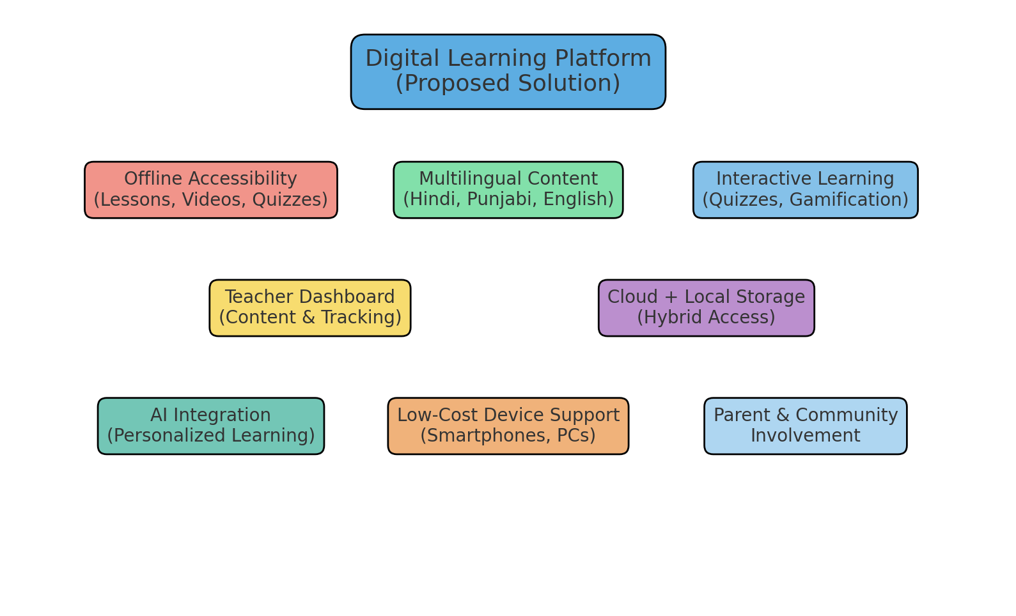
Proposed Solution
To address the challenges faced by rural school students in Nabha, we propose the development of a Digital Learning Platform that is affordable, offline-friendly, and tailored to rural needs.

Slide 6
Key Feautures of this Solution
Offline Accessibility: Lessons, videos, and quizzes can be accessed without
continuous internet.
Multilingual Content: Curriculum in Hindi, Punjabi, and English to break
language barriers.
Interactive Learning: Includes quizzes, assignments, and gamified activities
to boost engagement.
Teacher Dashboard: Tools for teachers to upload content, track student
performance, and provide feedback.
Cloud & Local Storage: Hybrid model for safe storage and easy content updates.
AI Integration: Personalized learning paths and recommendations based
on student progress.
Device-Friendly: Works on low-cost smartphones, tablets, and school PCs.
Community & Parent Involvement: Parents can monitor progress and
stay connected with teachers.

Slide 7
Technology Stack
Frontend (User Interface)
ReactJS / Angular → For responsive web apps
Flutter / React Native → For mobile app (Android/iOS)
HTML, CSS, JavaScript → Basic structure and styling
Backend (Application Logic)
Node.js / Express.js → Lightweight, scalable backend
Python (Django / Flask) → For AI personalization & APIs
Database (Storage)
MySQL / PostgreSQL → Structured learning content & user data
MongoDB → Flexible storage for multimedia files
SQLite (local) → Offline storage in student devices
Cloud & Deployment
AWS / Google Cloud / Azure → Hosting and scalability
Firebase → Authentication, real-time sync, push notifications
Docker → Containerization for smooth deployment

Slide 8
AI & Analytics
TensorFlow / PyTorch → Personalized learning models
Scikit-learn → Performance prediction & analytics
Google Analytics / Power BI → Usage monitoring & insights
Security
OAuth 2.0 / JWT → Secure login & authentication
SSL Encryption → Data privacy for users
Other Tools
Git / GitHub → Version control & collaboration
Figma / Canva → UI/UX design for learning apps
Zoom / Jitsi Integration → For live classes

Slide 9
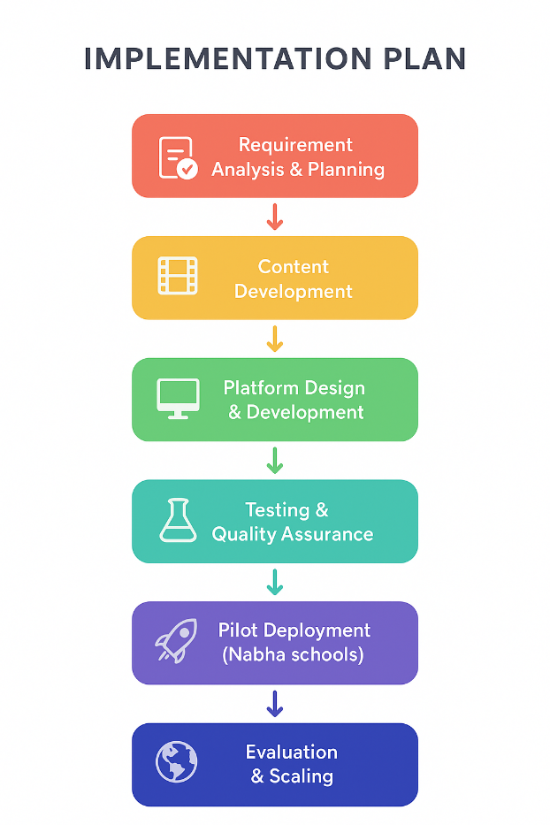
Implementation Plan

Slide 10
Phase 1 – Requirement Analysis & Planning
Identify key challenges in rural schools (internet, devices, language needs).
Collect requirements from teachers, students, and local education authorities.
Define scope, timeline, and resources.
Phase 2 – Content Development
Prepare digital lessons in Hindi, Punjabi, and English.
Include multimedia: text, audio, video, and quizzes.
Ensure offline-first compatibility.
Phase 3 – Platform Design & Development
Frontend: Build web + mobile apps (React/Flutter).
Backend: Set up server, database, and authentication.
AI Integration: Add adaptive learning recommendations.
Phase 4 – Testing & Quality Assurance
Test on low-cost devices with limited connectivity.
Collect feedback from a small group of students & teachers.
Fix bugs and improve usability.
Phase 5 – Pilot Deployment
Deploy platform in selected rural schools in Nabha.
Train teachers to use dashboard & upload lessons.
Monitor student performance and engagement.
Phase 6 – Evaluation & Scaling
Analyze usage data, quiz performance, and feedback.
Add improvements (more languages, subjects, gamification).
Scale to other rural areas with government/NGO support.

Slide 11
Impact of the project
Improved Access to Education – Quality digital learning even without internet.
Bridging Urban–Rural Divide – Equal opportunities for rural students.
Multilingual Learning – Content in Hindi, Punjabi, and English.
Empowered Teachers – Tools to track student progress and manage content.
Boosted Student Engagement – Gamified and interactive learning experience.
Cost-Effective & Scalable – Works on low-cost devices and expandable to other regions.

Slide 12
Future Scope
Expansion to Other Regions – Scale to more rural districts across India.
Integration with Government Platforms – Link with DIKSHA, SWAYAM & Digital India.
Advanced AI Features – Voice-enabled learning & adaptive assessments.
Skill Development & Vocational Training – Coding, agriculture tech, entrepreneurship.
Multilingual Expansion – Add more regional languages for inclusivity.
Sustainability & Offline Innovation – Solar-powered devices & smart kiosks.

Slide 13
Conclusion
Provides an affordable and accessible solution for rural education.
Ensures offline access, multilingual content, and interactive learning.
Bridges the urban–rural divide by empowering both students and teachers.
Creates a personalized and engaging learning experience.
Supports the Digital India vision and has strong potential for future expansion.

Slide 14
THANK YOU

